Slide 1
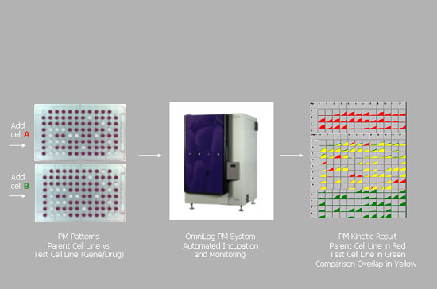
Biolog Phenotype Array Technology
Notes:
PMs use Biolog's patented redox chemistry, employing cell respiration as a universal reporter.
If the phenotype is strongly "positive" in a well, the cells respire actively, reducing a tetrazolium
dye and forming a strong color (Figure 2, left). If it is weakly positive or negative, respiration is slowed or stopped, and less color or no color is formed. The redox assay provides for both amplification and precise quantitation of phenotypes.

Slide 2
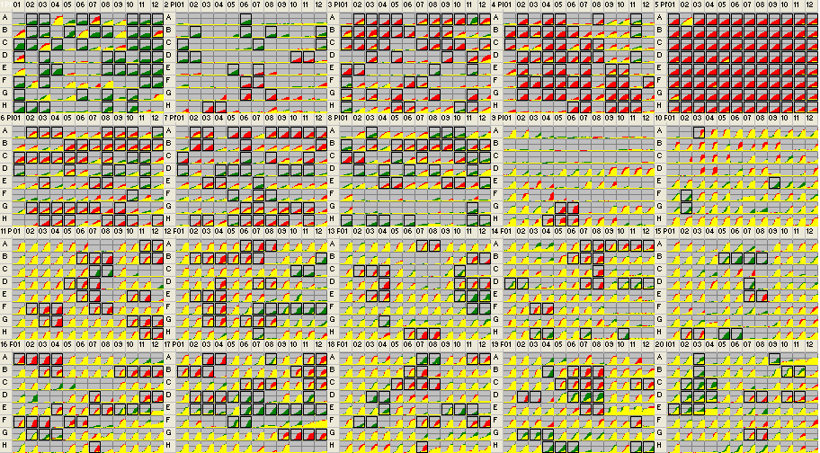
Sewper Rx Phenotype Arrays (PM1-20)
Consensus:
Pspp_SID_5842_MixCulture( green )
versus
Pput_SID_5841_Pputida( red )
Notes:
Boxed squares in green indicate Sewper Rx is able to grow above threshold while P. putida alone is not able to within 24hrs. Boxed squares in red indicate P. putida can grow whereas Sewper Rx cannot in the time frame tested (24hrs). Yellow peaks indicate both Sewper Rx and P. putida can grow similarly.

Slide 3
Sewper Rx Advantages versus P. putida:
Increased usage of carbon sources!
Phenotypes Gained:
PM17A A08 61 b-Chloro-L-alanine aa analog, alanine, aminotransferase inhibitor
PM20B A09 82 Benserazide aa metabolism, aromatic amino acid decarboxylase inhibitor
PM18C F02,F03 114 Semicarbazide hydrochloride amine oxidase inhibitor, carcinogen
PM20B B03 67 Orphenadrine anti-cholinergic
PM01 H01 125 Gly-Pro C-Source, amino acid
PM01 F01 104 Gly-Asp C-Source, amino acid
PM01 G06 92 Ala-Gly C-Source, amino acid
PM01 G01 81 Gly-Glu C-Source, amino acid
PM01 C01 186 D-Glucose-6-Phosphate C-Source, carbohydrate
PM01 E04 175 D-Fructose-6-Phosphate C-Source, carbohydrate
PM01 B07 147 D,L-a-Glycerol Phosphate C-Source, carbohydrate
PM01 E03 144 D-Glucose-1-Phosphate C-Source, carbohydrate
PM01 F12 131 Inosine C-Source, carbohydrate
PM01 A06 128 D-Galactose C-Source, carbohydrate
PM01 E12 127 Adenosine C-Source, carbohydrate
PM01 D09 122 a-D-Lactose C-Source, carbohydrate
PM01 B08 120 D-Xylose C-Source, carbohydrate
PM01 G08 120 N-Acetyl-D-Mannosamine C-Source, carbohydrate
PM01 B11 111 D-Mannitol C-Source, carbohydrate
PM01 C04 111 D-Ribose C-Source, carbohydrate
PM01 C10 108 Maltose C-Source, carbohydrate
PM01 A02 107 L-Arabinose C-Source, carbohydrate
PM01 C11 106 D-Melibiose C-Source, carbohydrate
PM01 D11 105 Sucrose C-Source, carbohydrate
PM02A E05 104 D-Glucosamine C-Source, carbohydrate
PM01 A11 102 D-Mannose C-Source, carbohydrate
PM01 C12 100 Thymidine C-Source, carbohydrate
PM01 E09 99 Adonitol C-Source, carbohydrate
PM01 E11 97 2`-Deoxyadenosine C-Source, carbohydrate
PM01 C06 94 L-Rhamnose C-Source, carbohydrate
PM01 A10 93 D-Trehalose C-Source, carbohydrate
PM01 E10 93 Maltotriose C-Source, carbohydrate
PM01 B03 92 Glycerol C-Source, carbohydrate
PM02A B06 91 D-Arabitol C-Source, carbohydrate
PM01 F11 90 D-Cellobiose C-Source, carbohydrate
PM02A C07 87 b-Methyl-D-Galactoside C-Source, carbohydrate
PM01 A03 83 N-Acetyl-D-Glucosamine C-Source, carbohydrate
PM02A B08 83 Arbutin C-Source, carbohydrate
PM02A D01 83 D-Raffinose C-Source, carbohydrate

Slide 4
Sewper Rx Advantages: resistance to chelators and detergents
PM01 E08 82 b-Methyl-D-Glucoside C-Source, carbohydrate
PM01 A12 80 Dulcitol C-Source, carbohydrate
PM01 D12 80 Uridine C-Source, carbohydrate
PM02A B12 79 3-0-b-D-Galactopyranosyl-D-Arabinose C-Source, carbohydrate
PM01 D08 77 a-Methyl-D-Galactoside C-Source, carbohydrate
PM02A D02 77 Salicin C-Source, carbohydrate
PM02A C01 75 Gentiobiose C-Source, carbohydrate
PM01 F03 72 m-Inositol C-Source, carbohydrate
PM01 B02 62 D-Sorbitol C-Source, carbohydrate
PM02A C12 62 Palatinose C-Source, carbohydrate
PM01 H10 149 D-Galacturonic Acid C-Source, carboxylic acid
PM01 H08 130 Pyruvic Acid C-Source, carboxylic acid
PM01 B05 125 D-Glucuronic Acid C-Source, carboxylic acid
PM01 C02 113 D-Galactonic Acid-g-Lactone C-Source, carboxylic acid
PM01 H02 102 p-Hydroxyphenyl Acetic Acid C-Source, carboxylic acid
PM02A B02 88 N-Acetyl-Neuraminic Acid C-Source, carboxylic acid
PM01 B10 85 Formic Acid C-Source, carboxylic acid
PM01 H03 75 m-Hydroxyphenyl Acetic Acid C-Source, carboxylic acid
PM01 D03 71 D-Glucosaminic Acid C-Source, carboxylic acid
PM01 G10 84 Methylpyruvate C-Source, ester
PM02A A06 104 Dextrin C-Source, polymer
PM14A H03,H04 142 EGTA chelator, Ca++
PM15B B05,B06,B07,B08 372 EDTA chelator, hydrophilic
PM18C A07,A08 241 Pyrophosphate chelator, hydrophilic
PM17A E06,E07,E08 356 Compound 48/80 cyclic AMP phosphodiesterase inhibitor
PM20B D02,D03,D04 202 Proflavine DNA intercalator, inhibits RNA synthesis
PM19 H04 102 Hexamminecobalt (III) Chloride DNA synthesis
PM12B F07,F08 139 Sulfathiazole folate antagonist, PABA analog
PM17A D05,D06,D07 166 Aminotriazole inhibits catalase, inhibits histidine synthesis
PM11C C07,C08 181 Colistin membrane, cyclic peptide
PM19 H11,H12 136 Polymyxin B membrane, cyclic peptide
PM12B B12 88 Polymyxin B membrane, cyclic peptide
PM17A E02,E03,E04 132 Niaproof membrane, detergent, anionic
PM19 B04 106 Methyltrioctylammonium chloride membrane, detergent, cationic
PM15B D07 85 Domiphen bromide membrane, detergent, cationic, fungicide
PM19 G02,G03,G04 237 Lauryl sulfobetaine membrane, detergent, zwitterionic
PM20B A03 81 Amitriptyline membrane, transport
PM03B A11 138 L-Cysteine N-Source, amino acid
PM03B F01 66 N-Acetyl-D-Mannosamine N-Source, other
PM03B E08 65 D-Glucosamine N-Source, other
PM03B E11 61 N-Acetyl-D-Glucosamine N-Source, other
PM08 H01 97 Gly-Gly-Ala N-Source, peptide
PM08 A08 96 Asp-Ala N-Source, peptide
PM08 A03 92 Ala-Asp N-Source, peptide
PM08 D11 91 Thr-Asp N-Source, peptide
PM08 D04 90 Pro-Ser N-Source, peptide
PM03B H01 87 Ala-Asp N-Source, peptide

Slide 5
Sewper Rx Advantages: increased usage of dipeptides as N-sources
PM07 E07 87 Ser-Pro N-Source, peptide
PM08 B01 85 Gly-Asp N-Source, peptide
PM08 D08 83 Ser-Asp N-Source, peptide
PM08 H03 82 Gly-Gly-Gly N-Source, peptide
PM08 G11 81 Ala-Ala-Ala N-Source, peptide
PM08 H04 80 Gly-Gly-Ile N-Source, peptide
PM08 C12 79 Pro-Asn N-Source, peptide
PM08 A10 78 Asp-Gly N-Source, peptide
PM08 H06 78 Gly-Gly-Phe N-Source, peptide
PM08 A09 77 Asp-Gln N-Source, peptide
PM08 D06 77 Pro-Val N-Source, peptide
PM07 F05 74 Thr-Pro N-Source, peptide
PM07 C06 73 Met-Pro N-Source, peptide
PM08 E12 73 Val-Pro N-Source, peptide
PM08 D02 72 Pro-lle N-Source, peptide
PM06 E11 70 Gly-Pro N-Source, peptide
PM08 H11 70 Phe-Gly-Gly N-Source, peptide
PM07 D05 69 Pro-Asp N-Source, peptide
PM08 B10 68 Leu-Pro N-Source, peptide
PM06 A12 67 Ala-Pro N-Source, peptide
PM07 D04 67 Pro-Ala N-Source, peptide
PM06 C10 66 Asp-Glu N-Source, peptide
PM06 D01 66 Asp-Phe N-Source, peptide
PM03B H10 63 Gly-Glu N-Source, peptide
PM08 C05 63 Phe-Asp N-Source, peptide
PM08 H12 63 Tyr-Gly-Gly N-Source, peptide
PM06 D09 62 Glu-Gly N-Source, peptide
PM06 C11 59 Asp-Leu N-Source, peptide
PM07 D01 59 Phe-Pro N-Source, peptide
PM06 D08 58 Glu-Glu N-Source, peptide
PM06 D11 58 Glu-Trp N-Source, peptide
PM07 D11 58 Pro-Pro N-Source, peptide
PM07 D09 57 Pro-Leu N-Source, peptide
PM07 D06 55 Pro-Gln N-Source, peptide
PM07 D10 53 Pro-Phe N-Source, peptide
PM08 C11 53 Pro-Arg N-Source, peptide
PM06 F10 52 His-Pro N-Source, peptide
PM07 F08 51 Trp-Asp N-Source, peptide
PM07 H05 51 Val-Asp N-Source, peptide
PM12B F09,F10,F11,F12 395 5-Fluoroorotic acid nucleic acid analog, pyrimidine
PM04A A11 62 Adenosine 2`,3`-Cyclic Monophosphate P-Source, organic
PM04A B11 56 Guanosine 2`,3`-Cyclic Monophosphate P-Source, organic
PM04A D11 54 Uridine 2`,3`-Cyclic Monophosphate P-Source, organic
PM10 G02 92 pH 9.5 + L-Norleucine pH, deaminase
PM10 E09 90 pH 9.5 + L-Histidine pH, deaminase
PM10 F02 83 pH 9.5 + L-Phenylalanine pH, deaminase
PM17A D11 90 Chlorpromazine phenothiazine, anti-cholinergic, anti-psychotic, sedative

Slide 6
Sewper Rx Advantages: resistance to toxic anions and cations
PM14A H07 61 Promethazine phenothiazine, anti-cholinergic, anti-psychotic, sedative
PM19 H05,H06 197 Thioglycerol reducing agent, thiol, adenosyl methionine antagonist
PM19 D06,D07,D08 379 Iodonitro tetrazolium violet respiration
PM13B E10,E11,E12 273 Ruthenium red respiration, mitochondrial Ca++ porter
PM20B C02,C03,C04 275 Thioridazine respiration, uncoupler
PM20B E01,E02,E03 176 Crystal Violet respiration, uncoupler
PM20B B10,B11 123 Tetrazolium violet respiration, uncoupler
PM15B H05,H06 221 Hydroxyurea ribonucleotide DP reductase inhibitor, antifolate
(inhibits thymine and methionine synthesis)
PM16A E09,E10,E11 195 Rifamycin SV RNA polymerase
PM12B H07 62 Rifampicin RNA polymerase
PM18C D03,D04 159 Sodium m-arsenite toxic anion
PM18C E04 96 Sodium metasilicate toxic anion
PM13B C10 72 Potassium chromate toxic anion
PM17A E09,E10,E11,E12 286 Sodium tungstate toxic anion, molybdate analog
PM14A H10 68 Sodium orthovanadate toxic anion, PO4 analog
PM14A D10,D11,D12 134 Sodium dichromate toxic anion, SO4 analog
PM18C E09,E10,E11 169 Antimony (III) chloride toxic cation
PM16A G02,G03,G04 147 Chromium chloride toxic cation
PM13B F11,F12 142 Thallium (I) acetate toxic cation
PM14A D01,D02 100 Cadmium chloride toxic cation
PM13B G04 68 Cobalt chloride toxic cation
PM17A F05,F06 207 D,L-Methionine hydroxamate tRNA synthetase
PM12B C10,C11 158 D,L-Serine hydroxamate tRNA synthetase

Slide 7
Sewper Rx Tolerance Characteristics
  pH range: 4.5 to 10; above 10 not tested. Bacterial growth inhibited at pH 4.0 and below.
  Salt tolerance: Grew in 1-3% NaCl; inhibited by 4% NaCl
  Potassium Chloride (used in fertilizers): Grew in 3 and 4% KCl; inhibited at 5% or greater.
  Sodium sulfate (used in detergents): Grew in 2-5%. 5% highest tested.
  Ethylene glycol (used in antifreeze): Grew in 5-20%; 20% highest tested.
  Urea (used in fertilizers as source of N): Grew in 2-4%; inhibited by 5% or greater.
  Sodium phosphate (food additive; emulsifier for processed cheeses): grew in 20-200 mM (pH 7); 200 highest conc tested.
  Ammonium sulfate (fertilizer- lowers pH and provides source of N): grew in 10-100 mM (pH 8); 100 highest conc tested.

Slide 8
Sewper Rx Substrate Utilization
(not all-inclusive)
  Carbon: See extensive list on previous slides. Lactose, etc.
  Nitrogen: Ammonia (Nitrate, Nitrite and Urea mostly P. putida in first 24 hrs).
  Phosphorus: Phosphoglycolic acid; glucose phosphate; glucosamine phophate (phosphate alone - mostly P. putida).
  Sulfur: All P. putida - sulfate, thiosulfate, thiophosphate, butane sulfonic acid, hydroxyethane sulfonic acid; methane sulfonic acid.

